Slide 1
Soccer Predictions
Soccer Predictions
By Domingo Imperatori

Slide 2
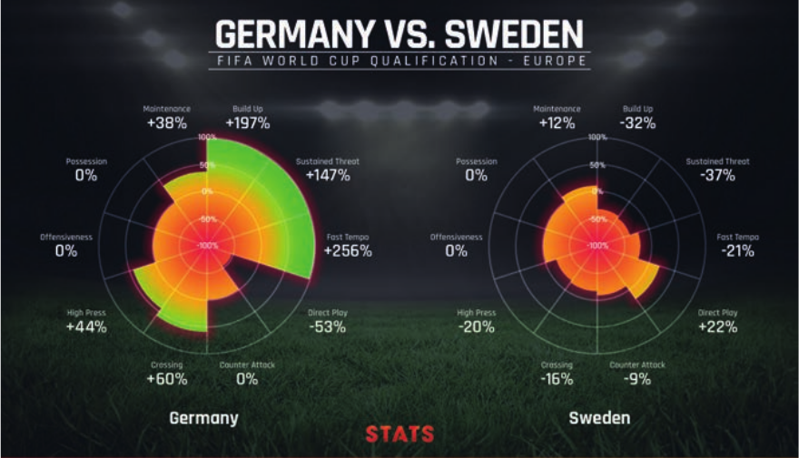
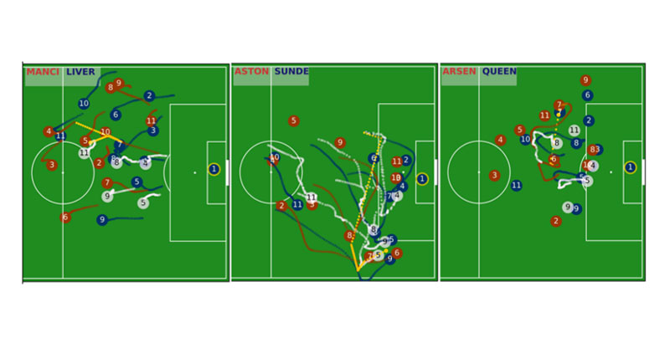
Project Goal
Understand how predictable is Soccer, and what are some of the features that have influence in the matches outcome.

Slide 3
Data
Data from Kaggle
* kaggle:
https://www.kaggle.com/mkhvalchik/soccer/data
https://www.kaggle.com/hugomathien/soccer
data of:
+25,000 matches
+10,000 players
11 European Countries with their lead championship
Seasons 2008 to 2016
Players and Teams' attributes* sourced from EA Sports' FIFA video game series, including the weekly updates
Team line up with squad formation (X, Y coordinates)
Betting odds from up to 10 providers
Detailed match events (goal types, possession, corner, cross, fouls, cards etc...) for +10,000 matches.
* Other Databases.

Slide 4
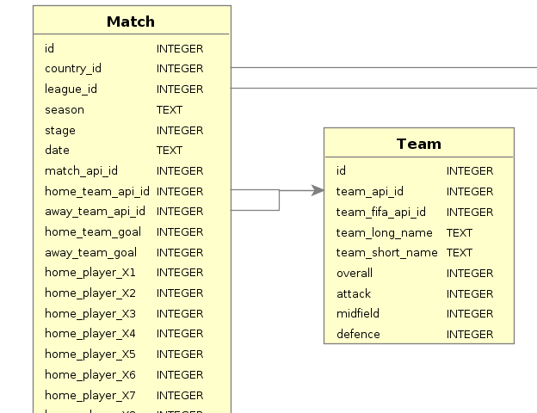
Data
We will focus in 2 tables:
  Matches: more than 25,000 matches European leagues
  Team (299 teams)

Slide 5
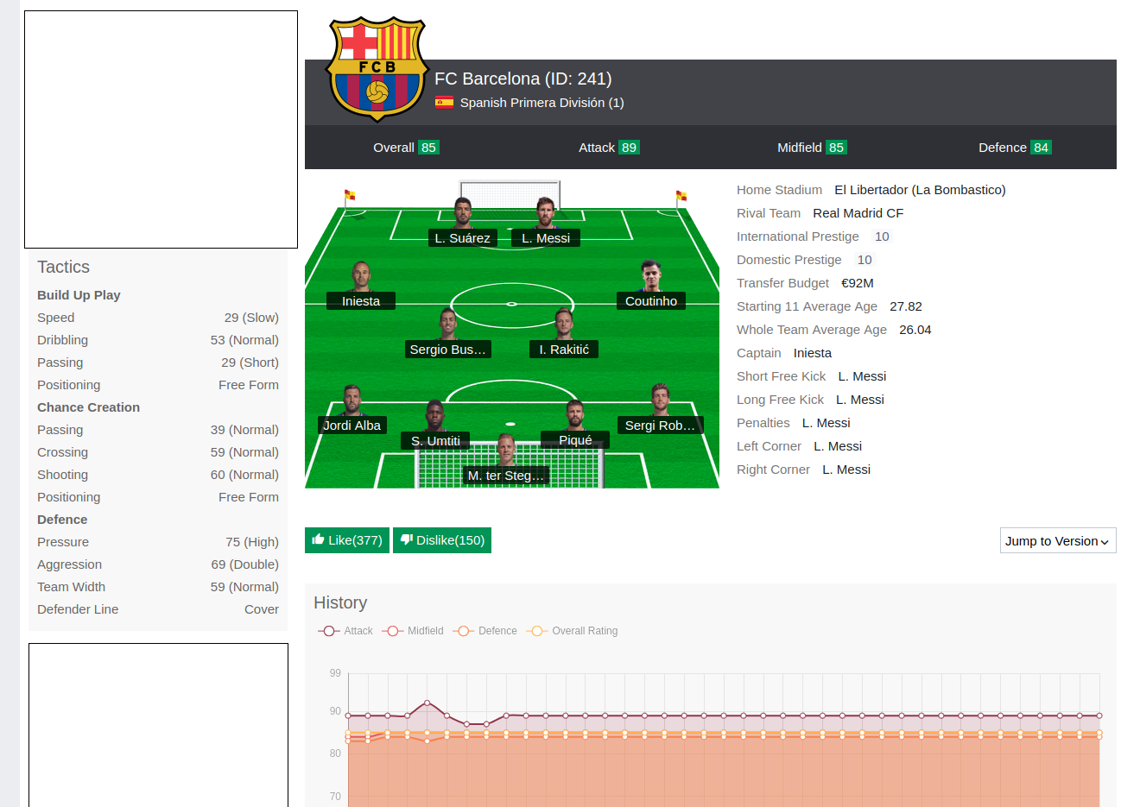
Team
We scrap some data from www.sofifa.com
Specifically:
Overall: how good is the team in total
Attack: how good is attacking
Midfield: how good is team midfield
Defence: how good is team defense

Slide 6
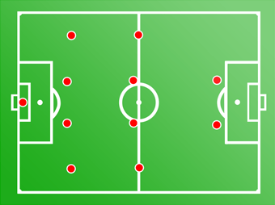
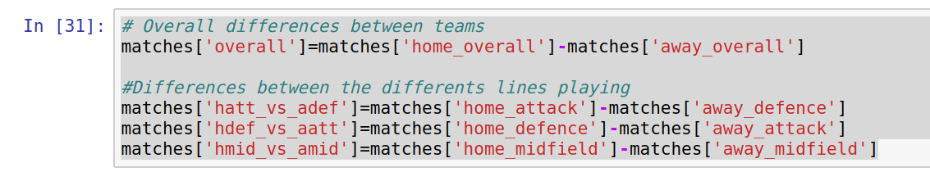
Feature engineering
After importing and cleaning data.
Differences between the different team crossing lines
  example: home team attacking,visitor team defending
att_vs_def
mid_vs_mid
def_vs_att

Slide 7
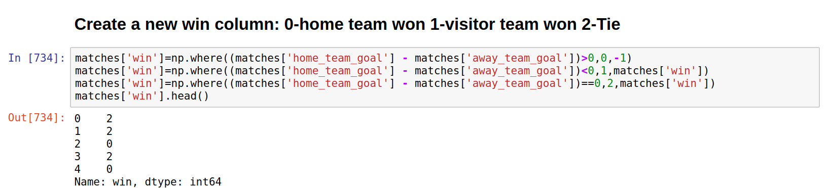
Column win
Create column win from matches ( score: home_team_goal,away_team_goal):
  0 : Home Team wins
  1 : Visitor Team wins
  2 : Draw

Slide 8
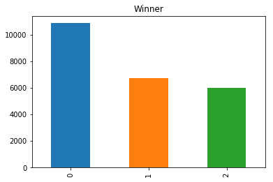
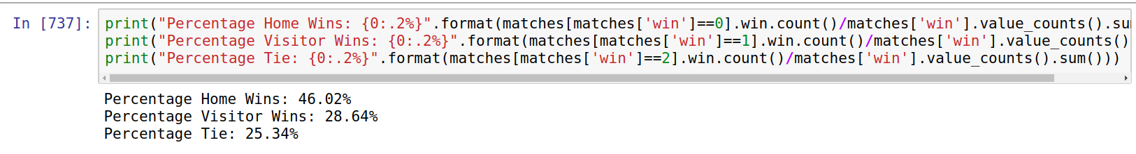
Home Factor
The home team winning is clearly the option most probable, second visitor winning (around 17% less) and finally draw the less probable

Slide 9
Goal
Logically the goal is a decisive part of the game, so the team that score the most and receive the less got clearly more chances of winning.
Engineering features from goal:
  Mean of goals score by team in all the matches.
  Mean of goals received by team in all the matches.
  Effectiveness: difference between the mean of goals score and the goals received.
  Created this features for playing as home and playing as visitor.

Slide 10
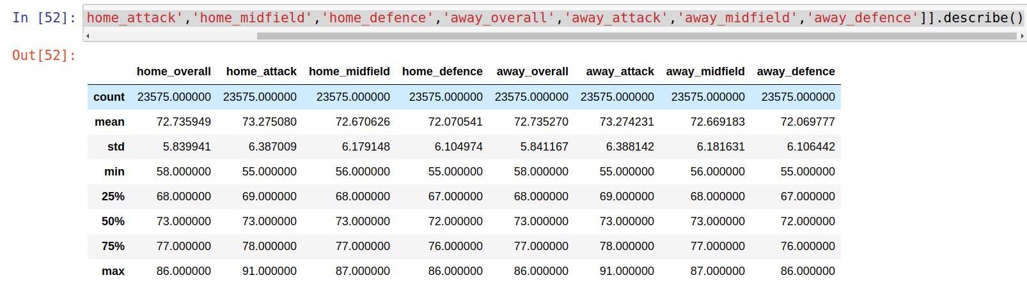
Describe matches:

Slide 11
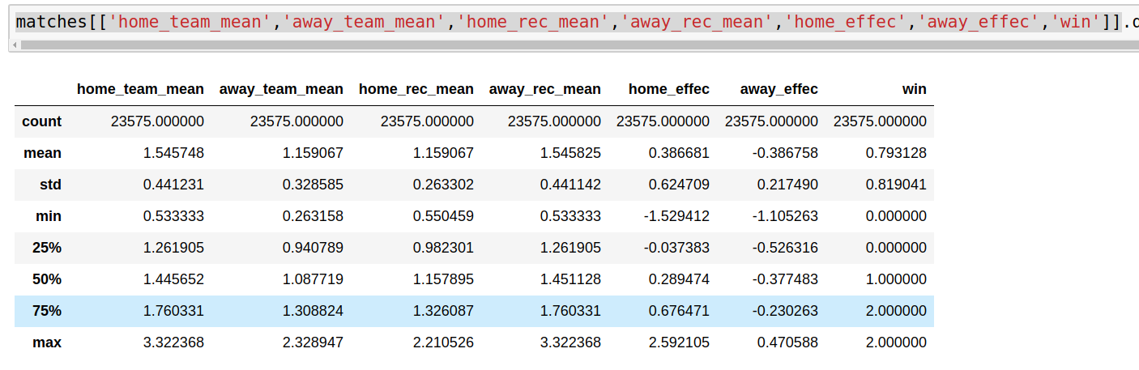
Describe 2:

Slide 12
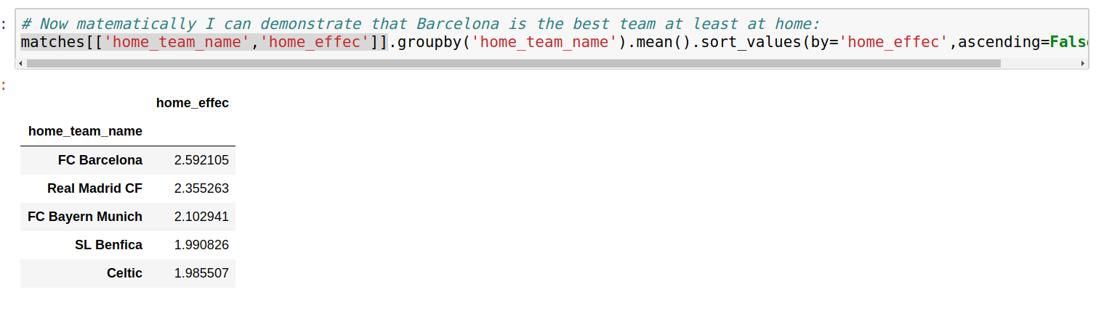

Barcelona best Team:

Slide 13
Exploratory Data Analysis
The problem is a classification type: we will try to figured out the match outcome using the different features :
  Home Win: 0
  Home Lost: 1
  Draw: 2

Slide 14
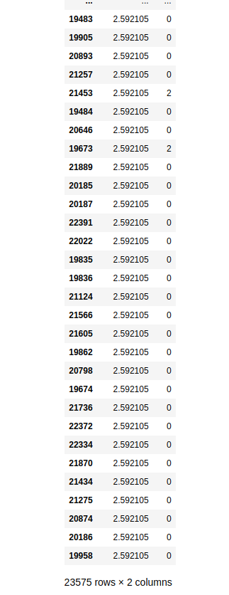
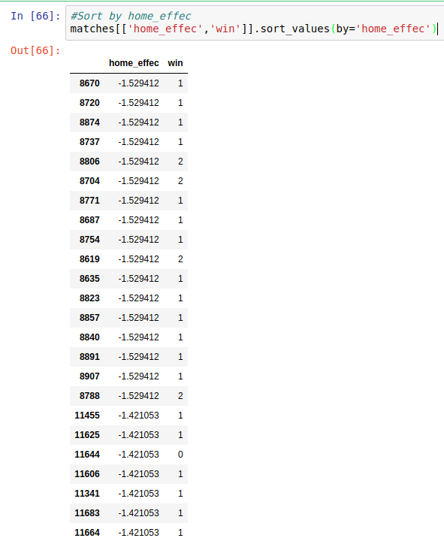
EDA 1
The first thing we can do is ordered by some of the variables for example
We can see that the effectiveness at home can be a good variable to discriminate:
Low Effec: means more 1 (Visitor wins)
High Effec: means more 0 (Home wins)

Slide 15
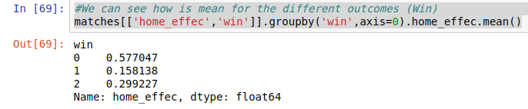
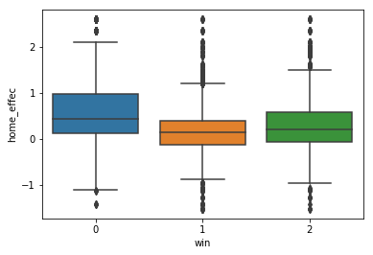

EDA 2

Slide 16
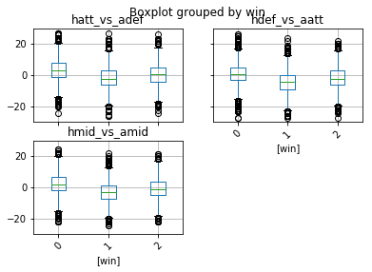
EDA 3

Slide 17
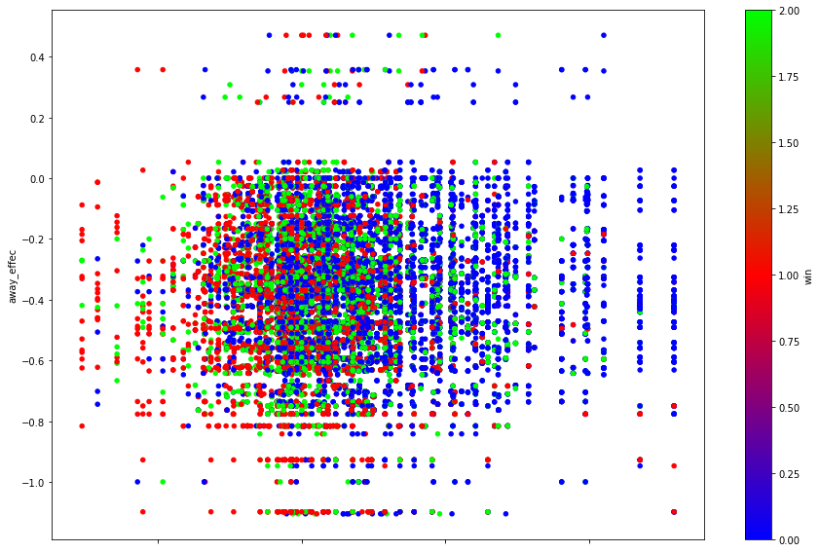
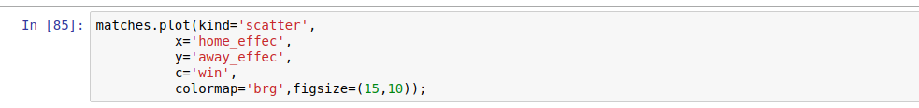
EDA 4

Slide 18
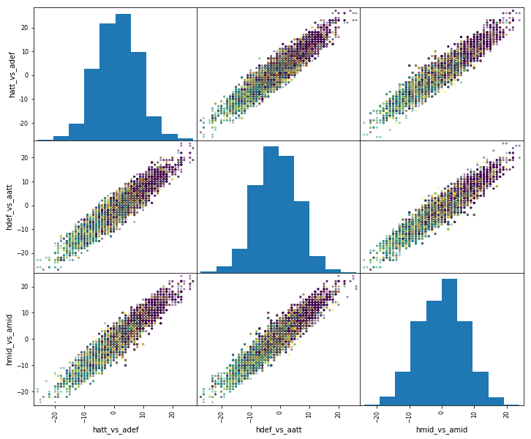
EDA 5

Slide 19
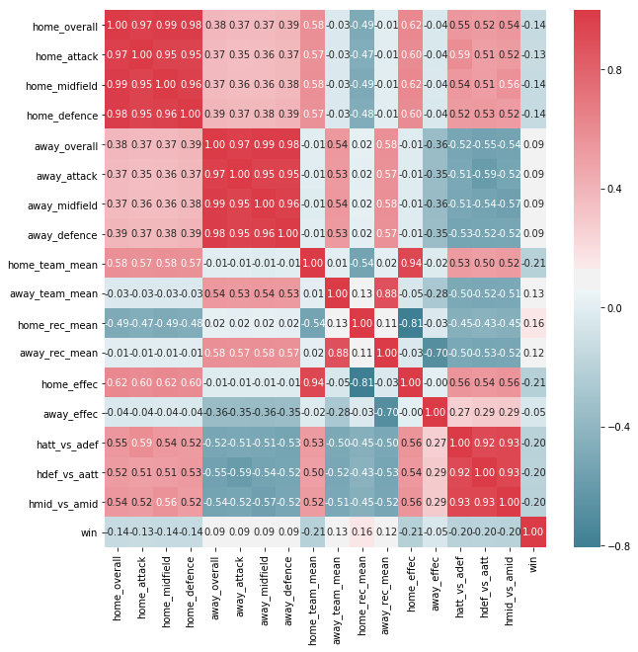
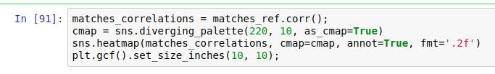
EDA 6

Slide 20
Models
Let’s check some models with the variables we choose:
K-Nearest Neighbors
Logistic Regression
Random Forest

Slide 21
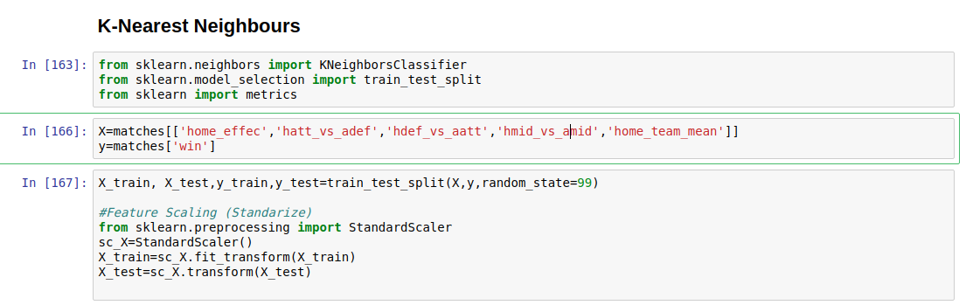
K-Nearest Neighbors

Slide 22
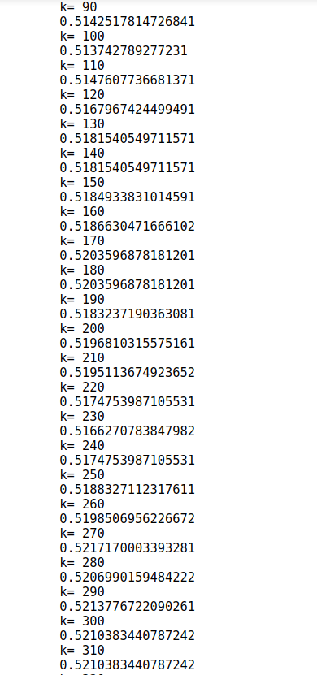
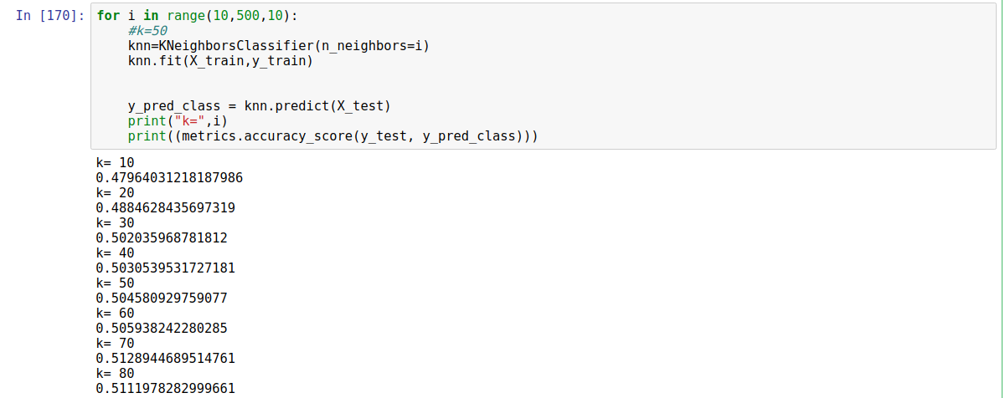
KNN-2

Slide 23
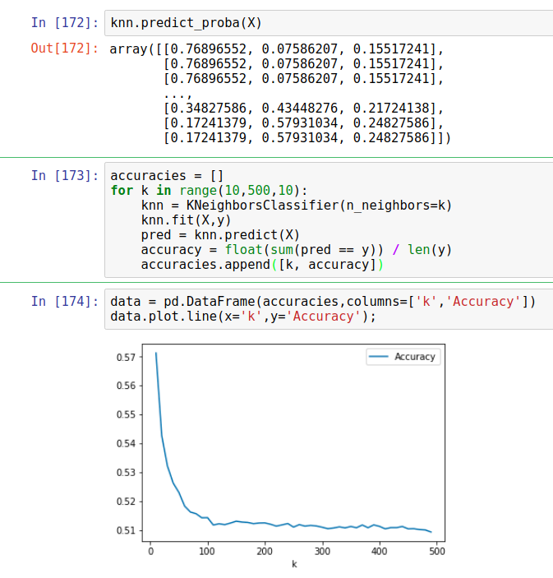
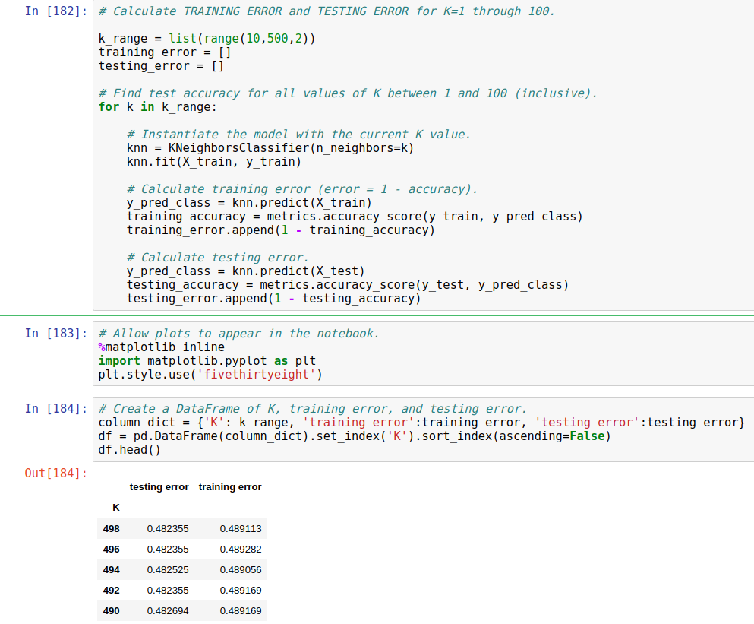
KNN-3

Slide 24
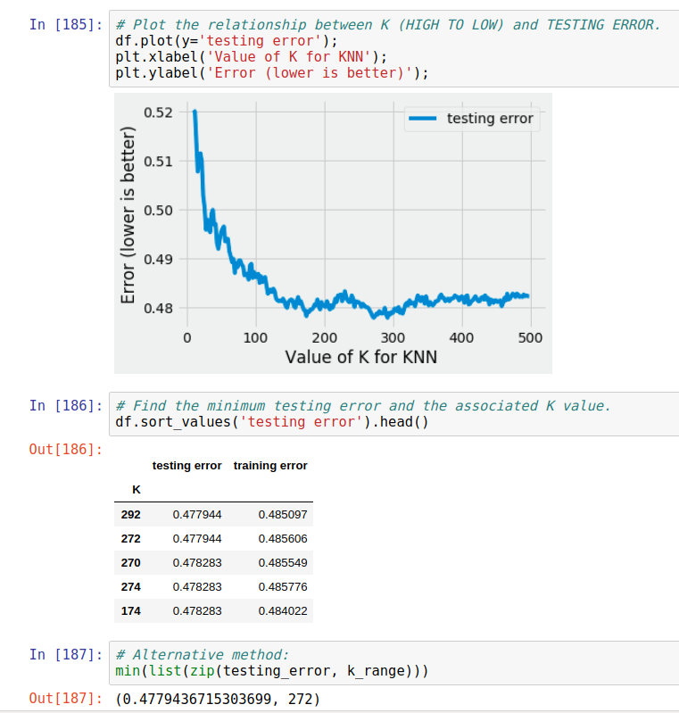
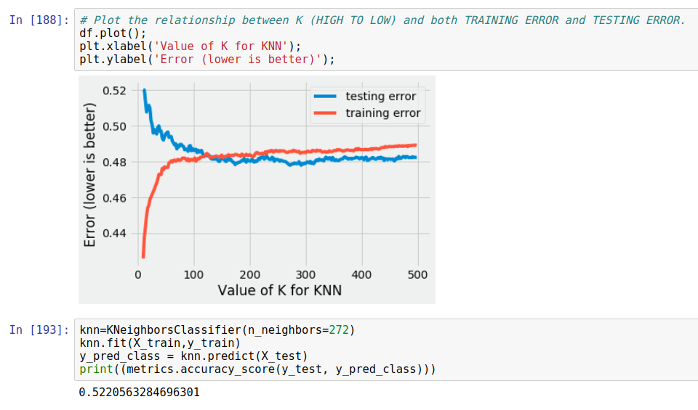
KNN-4
The best Predictions is: 52% (k=272)

Slide 25
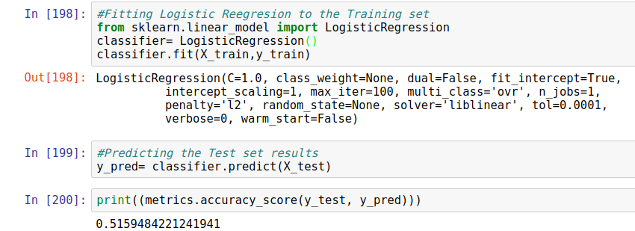
Logistic Regression
The best Predictions is: 51% (almost 52)

Slide 26
Random Forest

Slide 27
Conclusions
It’s a really complex game, I red max accuracy is 70%
The home field advantage is an important factor.
Applying the methods to the data:
KK-N | Logistic Regression | Random Forest
52% | 51%

Slide 28
Extensions
Check at other level, for example go to Player level, how for example can affect the experience (age) of the player in the game outcome
Use the betting companies data (matches) and match with our data
Check the outcome with other data

Slide 29
Thank You
  Email: d.imperatori.bou@gmail.com
  GitHub: https://github.com/dimperatori

